Slide 2
Unit 1: Programming Languages And Problem Solving (6hrs)
Programming Languages (machine-level language, assembly language, and high-level language) and its generations.
Software and its types
Structured programming
Problem-solving using computer - Problems Analysis (understanding of the problem, feasibility, and requirement analysis), Design (Algorithm and flowchart), Coding (compilation/interpretation and execution), Testing and debugging, Implementation, Evaluation, and Maintenance of computer programs, Program documentation

Slide 3
Computer System
Hardware - physical parts of the computer
Software - instructions to the computer
Data - raw facts the computer can manipulate
People - also known as users

Slide 4

What does this represent?

Slide 5
Software
A computer is an electronic device and can’t do anything on its own. It must be instructed to do a desired job.
It is necessary to specify a sequence of instructions that a computer must perform to solve problems.
The sequence of instructions for the computer to perform a particular task that can be stored electronically is called a Computer Program.
The term Software refers to the Computer Programs, Routines, and Packages required to utilize and control the operation of the computer system.

Slide 6
Tasks of Software
To control and coordinate the hardware components and manage their performances
To enable the users to accomplish their required tasks

Slide 7
Software Types
Software
System Software
Operating System
Language processor
Utility Software
Device Drivers
Application Software
Tailored Software
Packaged Software

Slide 8


System Software
The software that is used to control and coordinate the hardware components and manage their performance is called System Software.
System software manages the computer hardware and provides a foundation for application software to run.
It includes the operating system, utilities, and drivers that make hardware operational and accessible to users and other programs.

Slide 9
System Software Types
Operating System
Language Processor
Utility Software
Device Drivers

Slide 10
Operating System
These software manage the resources and control the overall operations of the computer system.
The operating system provides the interface between the application software/user and hardware.
The primary purpose of this software is to keep the system operating efficiently while allowing the users access to the system.
Examples: Windows XP, 7, 11, Linux, UNIX, MAC OSX, Android, iOS etc.

Slide 11
Operating System
The basic functions of OS are:
Booting of computer
File management
Resource management
Process management
Schedule management
Memory management
IO management

Slide 12
Language Processor
They are those software that translate the programs written in other languages to the machine-level program.
Eg: Assembler, Interpreter, Compiler, etc.

Slide 13


Utility Software
Utility software helps in the smooth operation of the computer system.
Utility software is the supporting software that is used to perform specific tasks related to the maintenance of the computer system.
Some of the utility software are included in Operating System Software, and some are available as a separate utility in the market.
Examples: Norton Utilities, PC tools, WinZip, Partition magic, Backup Utility, Disk Defragmenter, etc.
They are used in virus scanning, disk repairing, system backup, etc.

Slide 14

Device Drivers
Specialized programs that allow the operating system to communicate with hardware devices, such as printers, graphics cards, and USB drives.

Slide 15
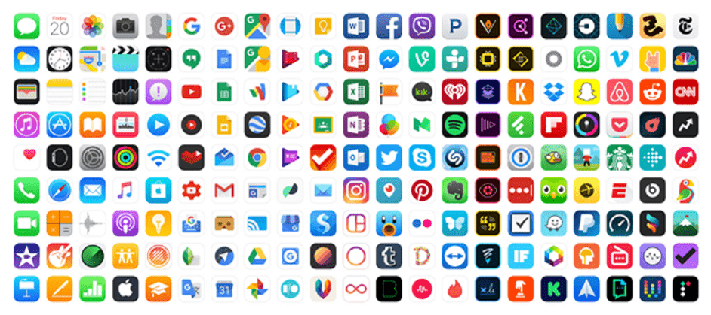
Application Software
Application software is a set of one or more programs designed to help users complete specific tasks or applications.
Application Software is also called Application Package.
Unlike system software, which works in the background, application software is directly accessed and controlled by the user.

Slide 16
Application Software
For example:
a payroll package produces pay slips as the output,
word processing jobs are done by word processing software (MS-word) and
School Management System processes examination results and produces mark sheets.

Slide 17
Application Software Types
Packaged or General-Purpose Software
Tailored or Bespoke or Customized Software

Slide 18







Packaged Software
Packaged software is software that is ready-made and available for sale, lease, or licensed to the general public.
They are designed to meet the common requirements of people.
Also known as General-Purpose Application Programs.
Eg: MS-office package, Adobe package, Web Browsers, Media Players, Graphic Software, Games And Entertainment, Educational Software, Mobile Apps, etc.

Slide 19
Tailored Software
Custom software is software that is specially developed for some specific organization or users that are unique to their operation areas.
It is made due to the specific requirement of the user.
For example, school management system, payroll package, mark sheet preparation, and so on.
Examples Inventory Management System, Pay-roll system, Library Management System, etc.

Slide 20
Structured Programming
Structured programming is a programming paradigm that emphasizes dividing a program into clear, manageable, and logical blocks.
It aims to improve readability, maintainability, and scalability by using a structured approach that avoids complex and unmanageable code.
The structured program consists of well-structured and separated modules.

Slide 21
Structured Programming
Example Scenario: Imagine a program to manage a library’s book inventory. In a structured program:
The program would be broken down into modules such as Add Book, Search Book, Delete Book, and View All Books.
Each module would use sequence, selection, and iteration to perform its respective tasks.
Functions like findBookByISBN and updateBookStatus could be reused across different parts of the program, enhancing code reusability.

Slide 22
Structured Programming
Modularity: The program is broken down into smaller sections or modules, each performing a specific task. Each module is self-contained, which allows it to be developed and tested independently.
Top-Down Design: The program is designed from a high level of abstraction down to specific details. The main problem is divided into sub-problems, which are further divided into smaller tasks.

Slide 23
Structured Programming
Control Structures: Structured programming relies on three main control structures:
Sequence: Executes statements in a sequential order.
Selection (Decision): Uses conditional statements like if, else, and switch to make decisions.
Iteration (Looping): Executes a set of statements repeatedly using loops like for, while, and do-while.

Slide 24
Structured Programming
Avoidance of Goto Statements: Structured programming discourages the use of goto statements, which can make code harder to read and maintain by creating unpredictable jumps in the code flow.
Functions/Procedures: These are self-contained blocks of code that perform specific tasks and can be reused within the program, enhancing modularity and reducing redundancy.

Slide 25
Structured Programming
On the contrary, in Assembly languages like Microprocessor 8085, etc., the statements do not get executed in a structured manner.
It allows jump statements like GOTO. So, the program flow might be random.

Slide 26
Advantages of Structured Programming
Readability: The code is easy to read, follow, and understand.
Maintainability: Code is easier to debug, update, and maintain, as each module or function is independent and performs a single task.
Reusability: Modular functions or procedures can be reused across different programs or projects.
Reduced Complexity: Structured programming helps in breaking down complex problems into manageable parts, making it easier to solve large-scale problems.

Slide 27
Examples of Structured Programming
C: Known for its use of functions and structured approach.
Pascal: Specifically designed to encourage structured programming.
Java (to an extent): Although object-oriented, Java also supports structured programming principles.

Slide 28
Programming Language Generations
Generation | Type | Description | Example
1GL | Machine Language | Direct binary code, unique to each CPU | Binary (101010)
2GL | Assembly Language | Mnemonics for machine-level instructions | x86 Assembly
3GL | High-Level Language | Abstracted languages, closer to human languages | C, Java, Python
4GL | Declarative Language | Focus on what to do, with specific domain applications | SQL, MATLAB
5GL | AI & Logic Programming | Focus on constraints and problem-solving, used in AI | Prolog, Mercury

Slide 29
End of Lecture 3

Slide 30
Problem-Solving Using Computer

